Slide 1
Responsive Web Design

Slide 2
Objectives
Define Responsive Web Design
Control viewport on mobile devices
Respond to device features with media queries
Organize content in fluid grids
Maintain image aspect ratios with flexible images
Serve high-resolution images to high-resolution devices

Slide 3
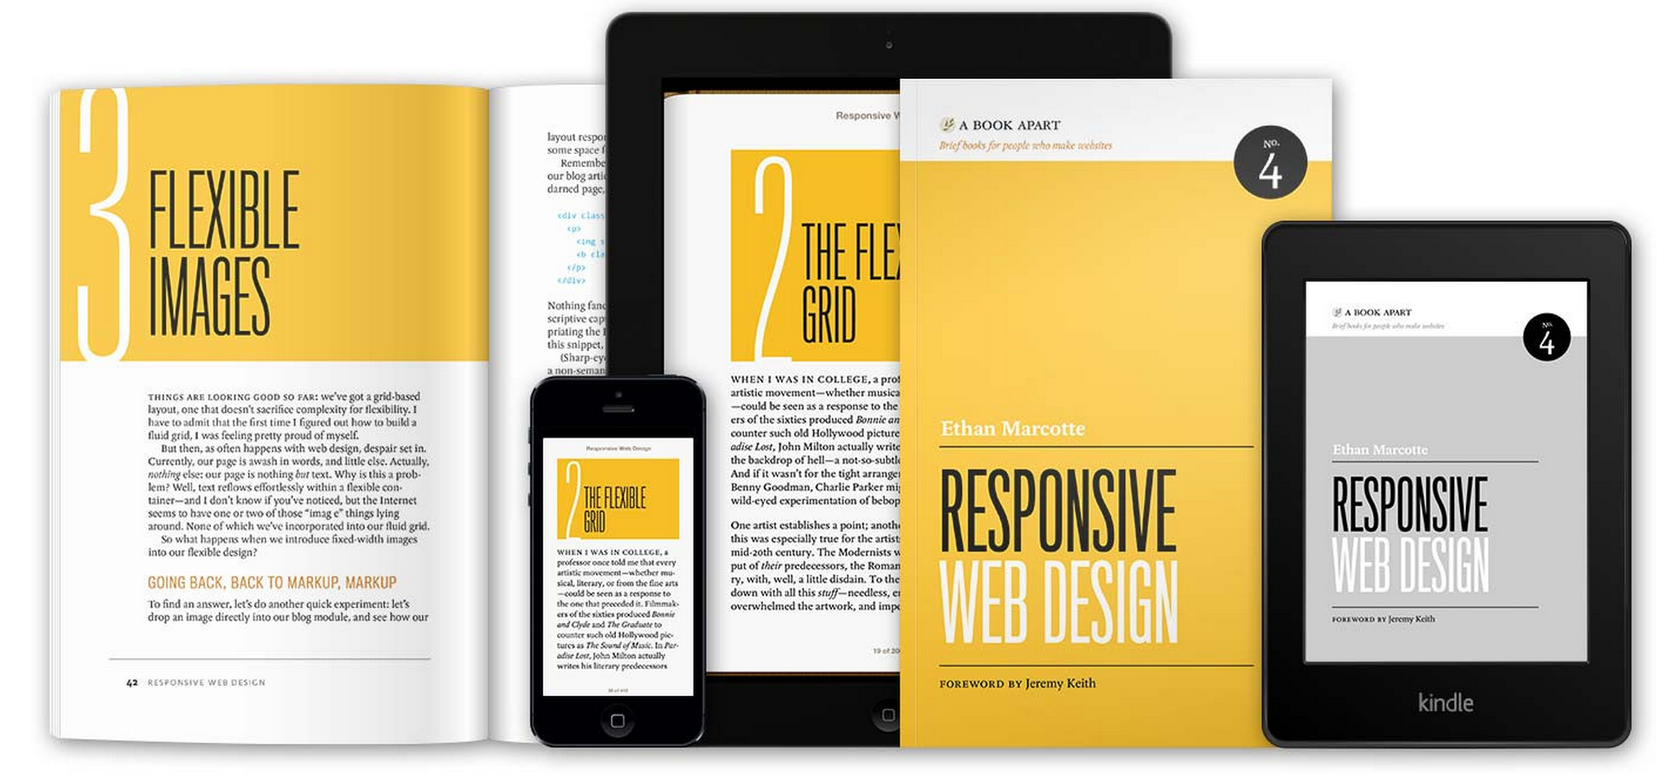
What is Responsive Web Design?
Coined in 2010 by Ethan Marcotte

Slide 4
Reading About Responsive Web Design
Short book available for purchase:
http://www.abookapart.com/products/responsive-web-design
Shorter article by the same author:
http://alistapart.com/article/responsive-web-design

Slide 5
Pillars of Responsive Web Design
Fluid grids
grid-based designs that scale with browser width
Flexible images
images that maintain aspect ratios as grid scales
Media queries
added in CSS3 to specify device-specific CSS rules

Slide 6
Thinking Differently
“Fluid grids, flexible images, and media queries are the three technical ingredients for responsive web design, but it also requires a different way of thinking.”
practicing Responsive Web Design involves a “mobile first” design philosophy
Mobile devices are the primary means of accessing the Web for many (soon to be most) people
starting design for constrained devices ensures content will always be accessible
easier to add than to remove

Slide 7
Viewports
Viewports on desktop browsers is visible area of page
resizing browser window changes viewport size
Viewports on mobile browsers are virtual
can be large or smaller than current visible area

Slide 8
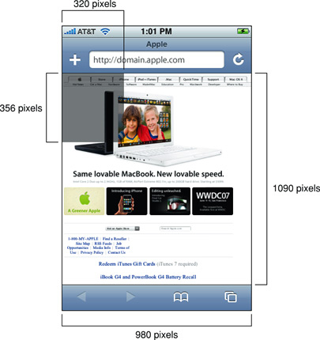
Default Viewport Settings
Mobile browsers default to a viewport width of 980px
assuming most sites were designed for desktop sizes
brower “zooms out” to fit entire viewport on screen

Slide 9
Changing Viewport Settings
Mobile browsers look for <meta name=“viewport”> elements in <head>
settings in content attribute override default viewport settings
used to set viewport width to device width
prevents browser from “zooming out”
<meta name="viewport"
content="width=device-width, initial-scale=1.0">

Slide 10
Media Queries
“if statements” for CSS files
Query a dozen different “media features” that describe characteristics of current device
Supports usual logical operators
not, and, or
Extends @media at-rules from CSS 2.1

Slide 11
Media Types
CSS 2.1 defined a set of media types for targeting specific devices:
all
braille
embossed
handheld
print
projection
screen
speech
tty
tv

Slide 12
Inline @media at-rules
Media-dependent rules can be declared inside @media blocks
#annoying-advertisment {
position: fixed;
}
@media print {
#annoying-advertisment {
display: none;
}
}

Slide 13
Media-dependent Style Sheets
Conditionally load style sheets with @import at-rules:
or <link> elements from HTML:
@import url('print.css') print;
<link rel="stylesheet" href="print.css" media="print">

Slide 14
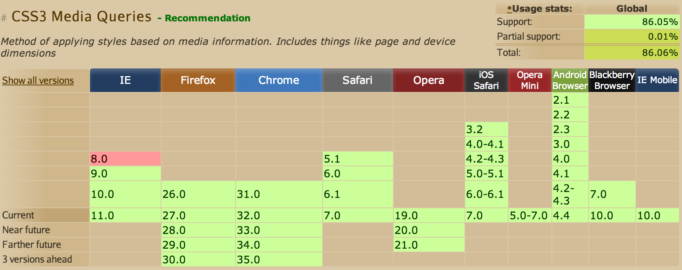
Browser Support for Media Queries
Too many variations in device types and incomplete browser implementations spawned an alternate approach
media queries introduced in CSS3

Slide 15
Extended Media Types
Media queries give style sheet authors the ability to inspect the physical characteristics of the rendering device
media queries are specified in same places as media types
prefix expression with “not” to negate
use “and” keyword as many to chain expressions
use “,” to separate alternate queries (like a logical OR)
media type and leading “and” can be omitted (same as “all and”)
prefix with “only” to hide from older browsers
@media screen and (max-width: 767px) {
#side-bar {
display: none;
}
}

Slide 16
Media Features
Media features that can be tested:
width
height
device-width
device-height
orientation
aspect-ratio
device-aspect-ratio
color
color-index
monochrome
resolution
scan
grid

Slide 17
Min and Max Prefixes
Most media features allow “min-” and “max-” prefixes
“min-” = “greater than or equal to”
“max-” = “less than or equal to”
@media (width: 768px) { /* width == 768px */ }
@media (max-width: 768px) { /* width <= 768px */ }
@media (min-width: 768px) { /* width >= 768px */ }

Slide 18
Fluid Grids
Fluid grid column widths scale with browser width
use % for widths
use media queries to break columns at specific widths

Slide 19
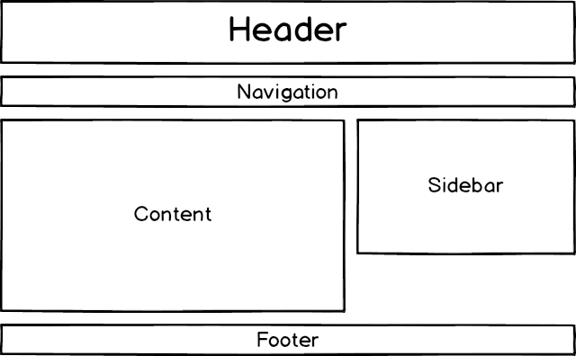
Typical Layout on Desktop Devices

Slide 20
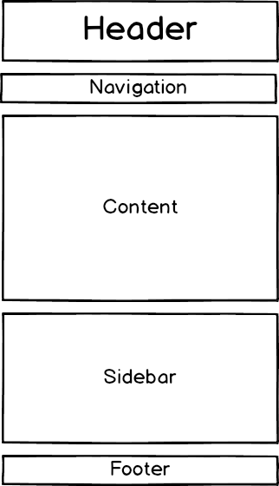
Typical Layout on Mobile Devices

Slide 21
Fluid Grid Tips
Set box-sizing to border-box
http://www.jefftk.com/p/the-revenge-of-the-ie-box-model
width will include content, padding, and border (but not margin)
math becomes much easier
If using floats for columns, use micro clearfix hack to avoid unsemantic elements
http://nicolasgallagher.com/micro-clearfix-hack/
Many options for equal height columns
http://css-tricks.com/fluid-width-equal-height-columns/
Flexbox is coming soon
http://philipwalton.github.io/solved-by-flexbox/
all of this will become much easier

Slide 22
Setting Break Points
Let content dictate break points
there are too many variations in too many devices to account for all of them
Use proportional break points (with ems) to enforce typographic rules
works even when use scales pages

Slide 23
Flexible Images
Images that maintain their aspect ratio as they flex
set max-width to 100%
do NOT set height (or set to auto)

Slide 24
High Pixel Density Displays
Not all pixels are the same
standard was 96dpi (dots or pixels per inch)
Apple’s “retina” is marketing speak for 192dpi
many Android devices also have high pixel density displays
CSS defines rules for reference pixels
different devices report different pixel densities according to this definition

Slide 25
Multiple Images with Media Queries
Media queries can be used to load background images appropriate for the current device
some WebKit-based browsers still require querying the proprietary “device-pixel-ratio” feature
standard feature for this (supported by most other browsers) is to query “resolution”
@media only screen and
(-webkit-min-device-pixel-ratio: 2),
(min-resolution: 192dpi)
{
/* High-res rules go here. */
}

Slide 26
Multiple Images with image-set
WebKit-based browsers have support for image-set() function
only usable from CSS
background-image: -webkit-image-set(
url(lowRes.png) 1x,
url(highRes.png) 2x
);

Slide 27
Multiple Images with srcset
Browsers are starting to add srcset attributes on <img> elements
similar to image-set() in CSS
<img src="fallback.jpg" alt="" srcset="small.jpg 640w 1x, small-hd.jpg 640w 2x, med.jpg 1x, med-hd.jpg 2x">

Slide 28
Multiple Images with <picture> element
Community pushing adoption of new <picture> element
http://responsiveimages.org/
<picture>
<source media="(min-width: 40em)" srcset="big.jpg 1x, big-hd.jpg 2x">
<source srcset="small.jpg 1x, small-hd.jpg 2x">
<img src="fallback.jpg" alt="">
</picture>

Slide 29
Picturefill
Polyfill that mimcs proposed <picture> element
https://github.com/scottjehl/picturefill
<span data-picture data-alt="A giant stone face at The Bayon temple in Angkor Thom, Cambodia">
<span data-src="small.jpg"></span>
<span data-src="medium.jpg" data-media="(min-width: 400px)"></span>
<span data-src="large.jpg" data-media="(min-width: 800px)"></span>
<span data-src="extralarge.jpg" data-media="(min-width: 1000px)"></span>
<!-- Fallback content for non-JS browsers. Same img src as the initial, unqualified source element. -->
<noscript>
<img src="small.jpg" alt="A giant stone face at The Bayon temple in Angkor Thom, Cambodia">
</noscript>
</span>

Slide 30
Summary
Responsive Web Design allows a single app to respond to the needs of many devices with:
fluid grids
flexible images
media queries
Mobile first approach to design ensures content should be accessible to most users

